Slide 1
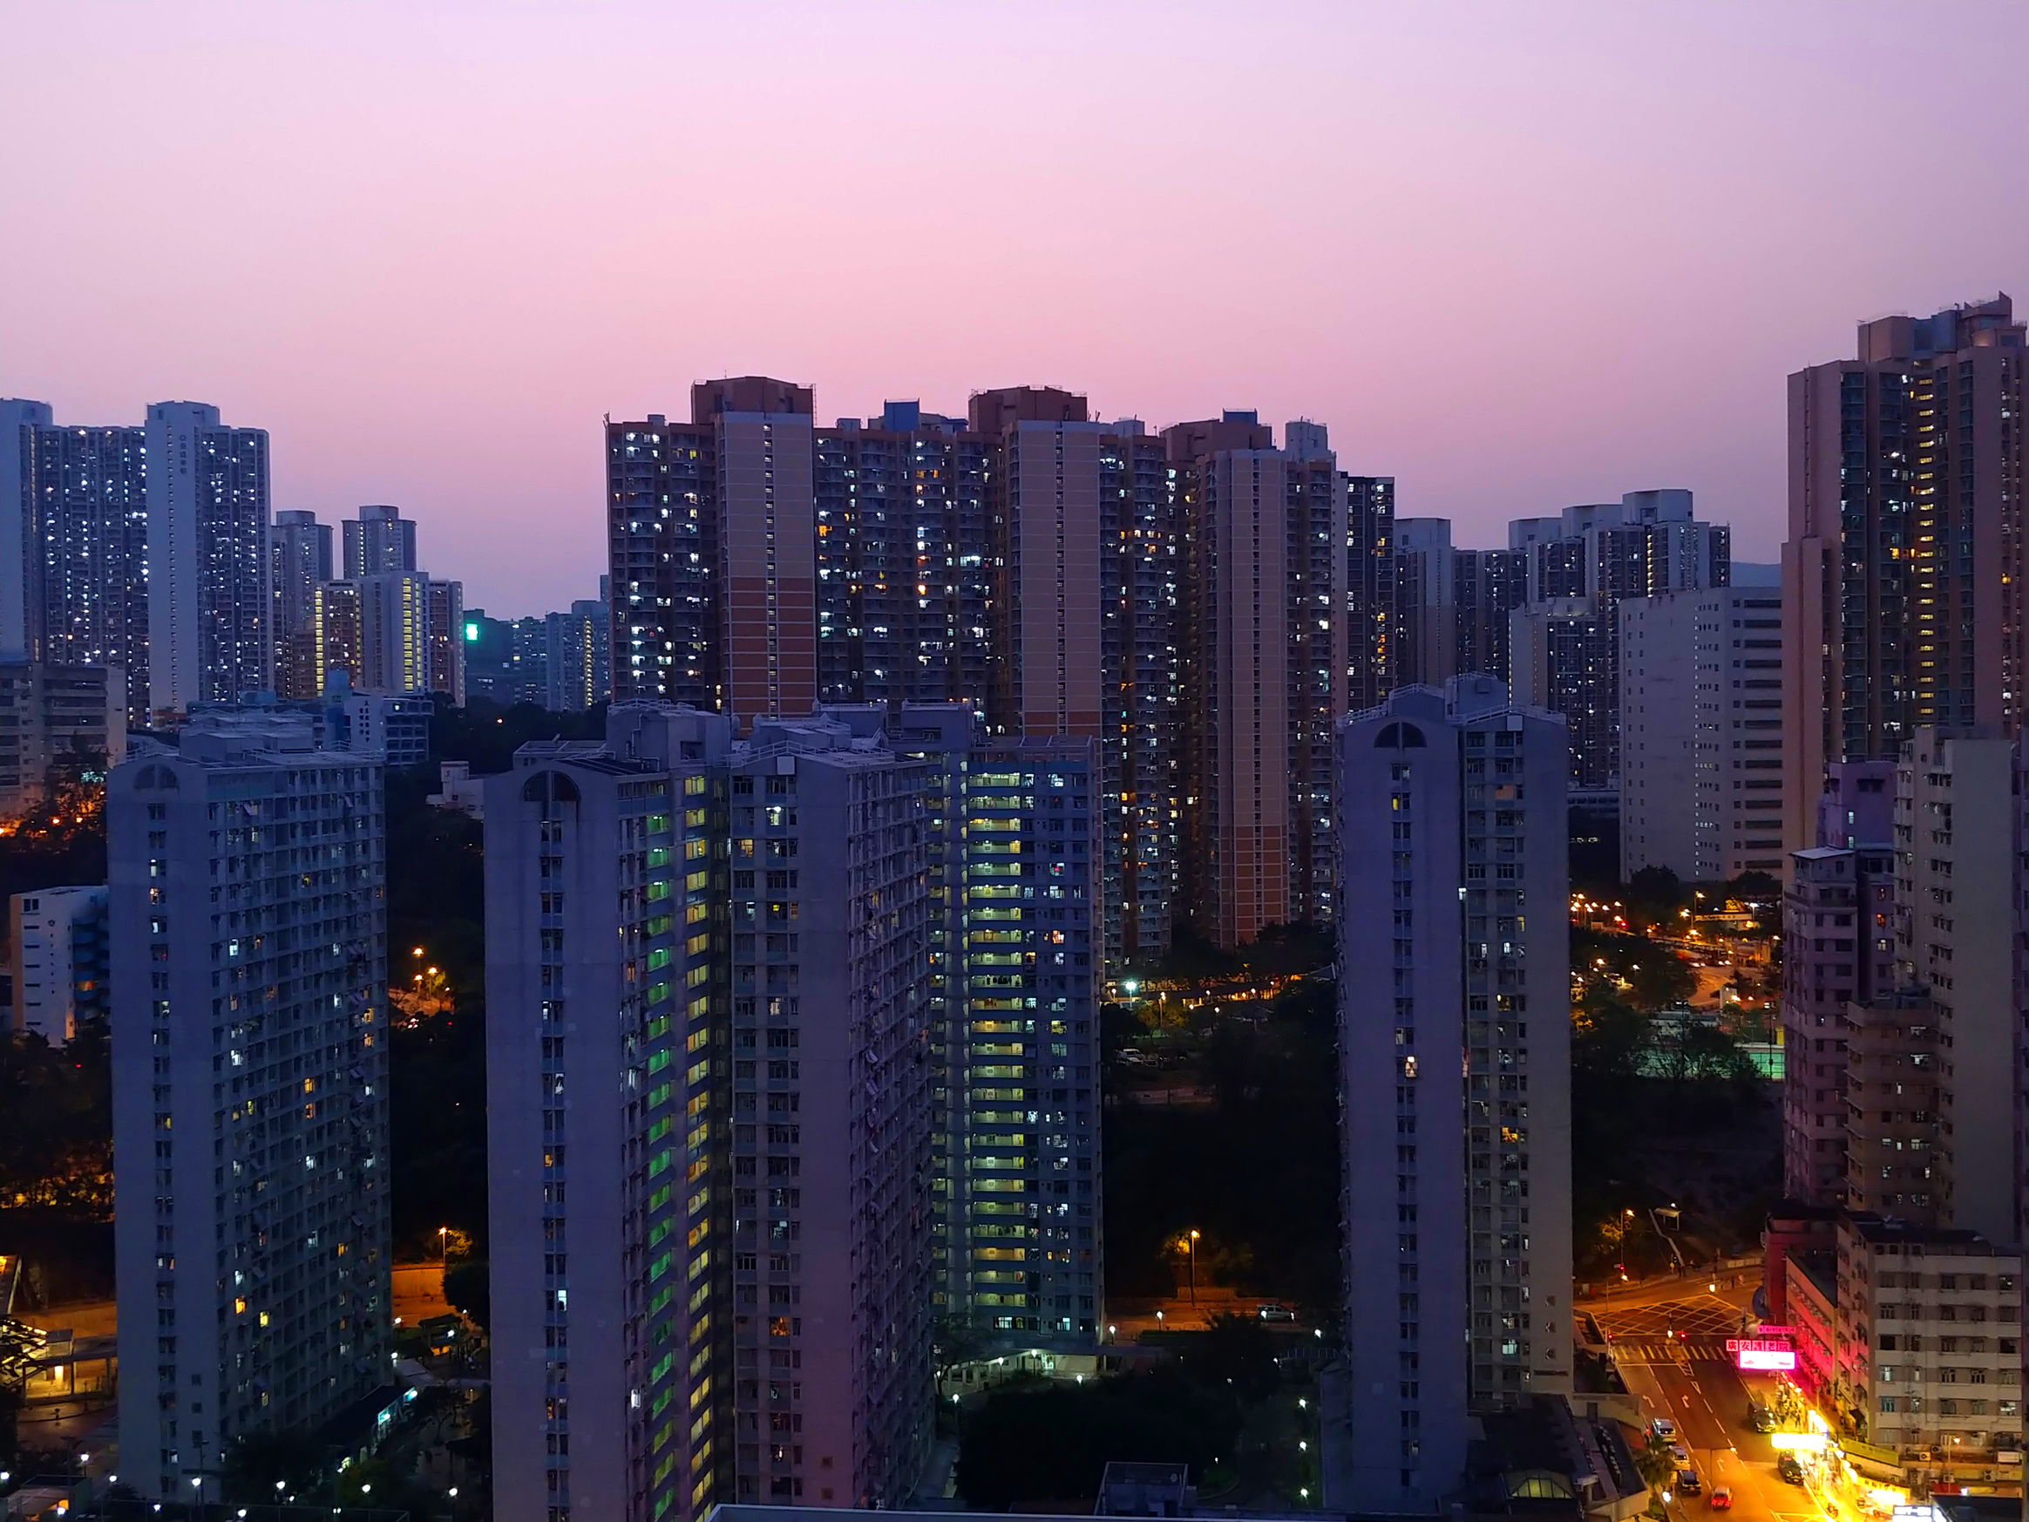
ECO 590
NYC Urbanization & MTA Public Transit Infrastructure
Bella Germani

Slide 2
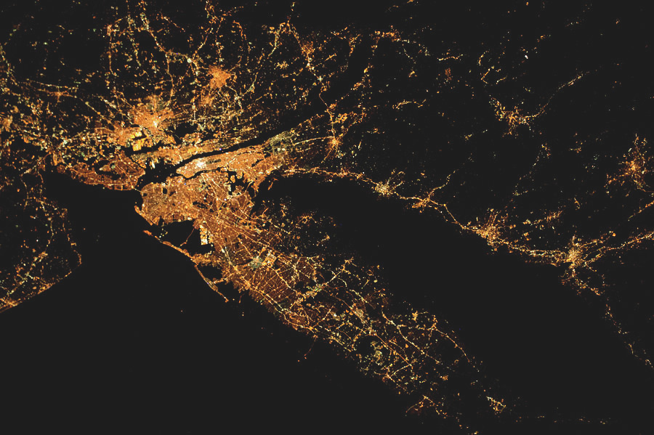
Research Question
Does the level of urbanization in New York City (as measured by nighttime light intensity) have an impact on the quality of MTA Infrastructure (as measured by passenger safety and ridership levels)?

Slide 3
VARIABLES & DATA COLLECTION (2015-2020)
Initial Value
Final Value
01
NASA NTL Intensity
Used as a measure of urbanization
Obtained via Google Earth Engine API
Nightly pixel intensity for NYC ROI
Monthly average light intensity
02
Metro Card Count
Used as a measure of MTA subway ridership
Obtained from NYC dept of transit
Daily purchases of each metrocard tyoe
Monthly average purchases of metrocards across all types
03
Total Major Incidents
Used as measure of passenger safety
Obtained from NYC dept of transit
Daily number of incidents in each category
Monthly average number of total incidents
04
Major Incidents by category
Subsets of total incidents variable
Daily number of incidents in each category
Monthly average number of incidents in each category

Slide 4
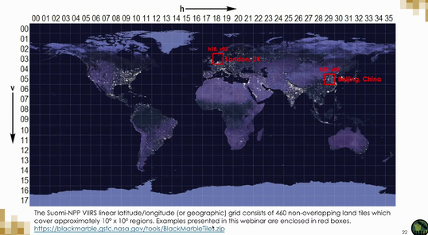
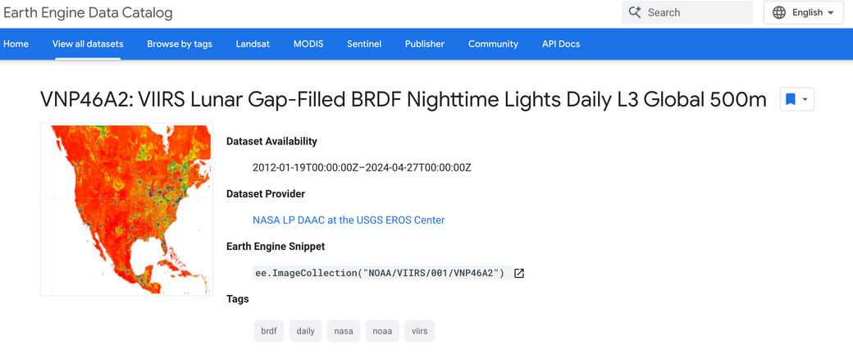
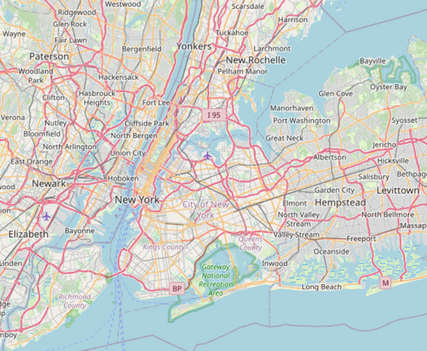
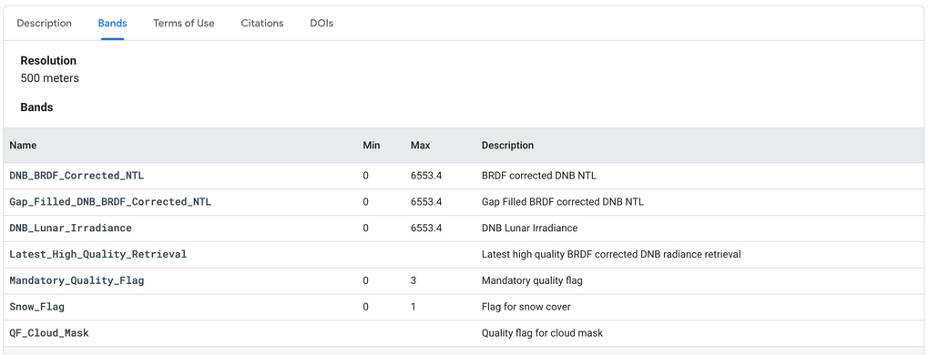
NASA NTL Variable Collection Process
Watched training video on satellite product and how to collect the data from an API
Setup Google EarthEngine API cloud account & authentication
Looked thorough documentation (much more user friendly & easier to navigate than NASA’s)
Types of image collections & how to call metadata for each image
NASA NTL Specific band info, user guide, & output types/structures
Visualization paramerers & tutorials
Found call and visualization examples
Put together my request in VScode

Slide 5
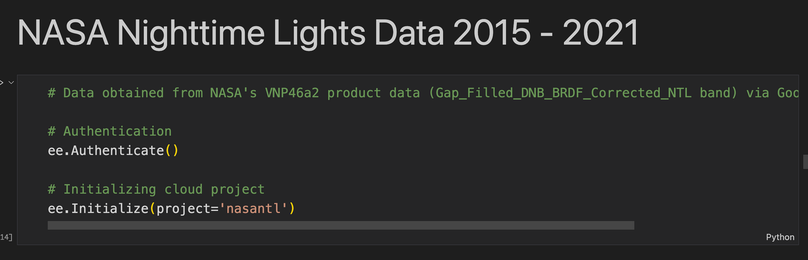
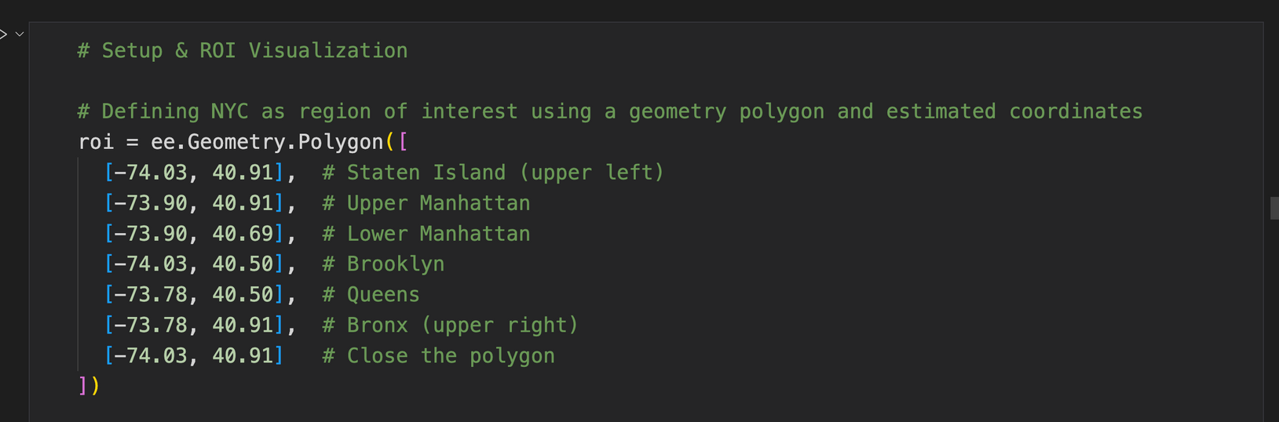

Slide 6
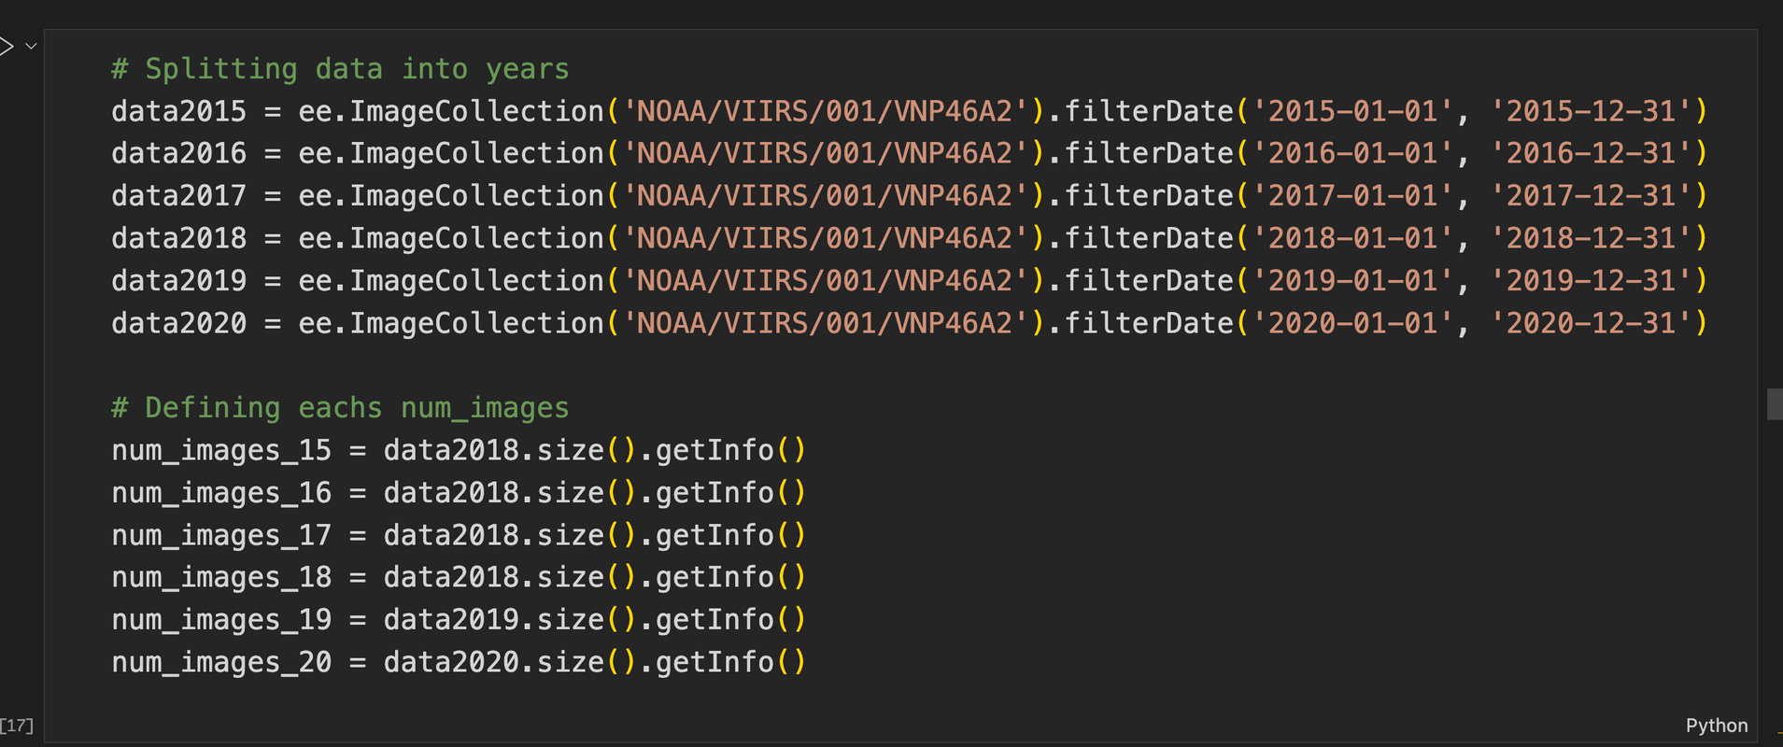

Slide 7
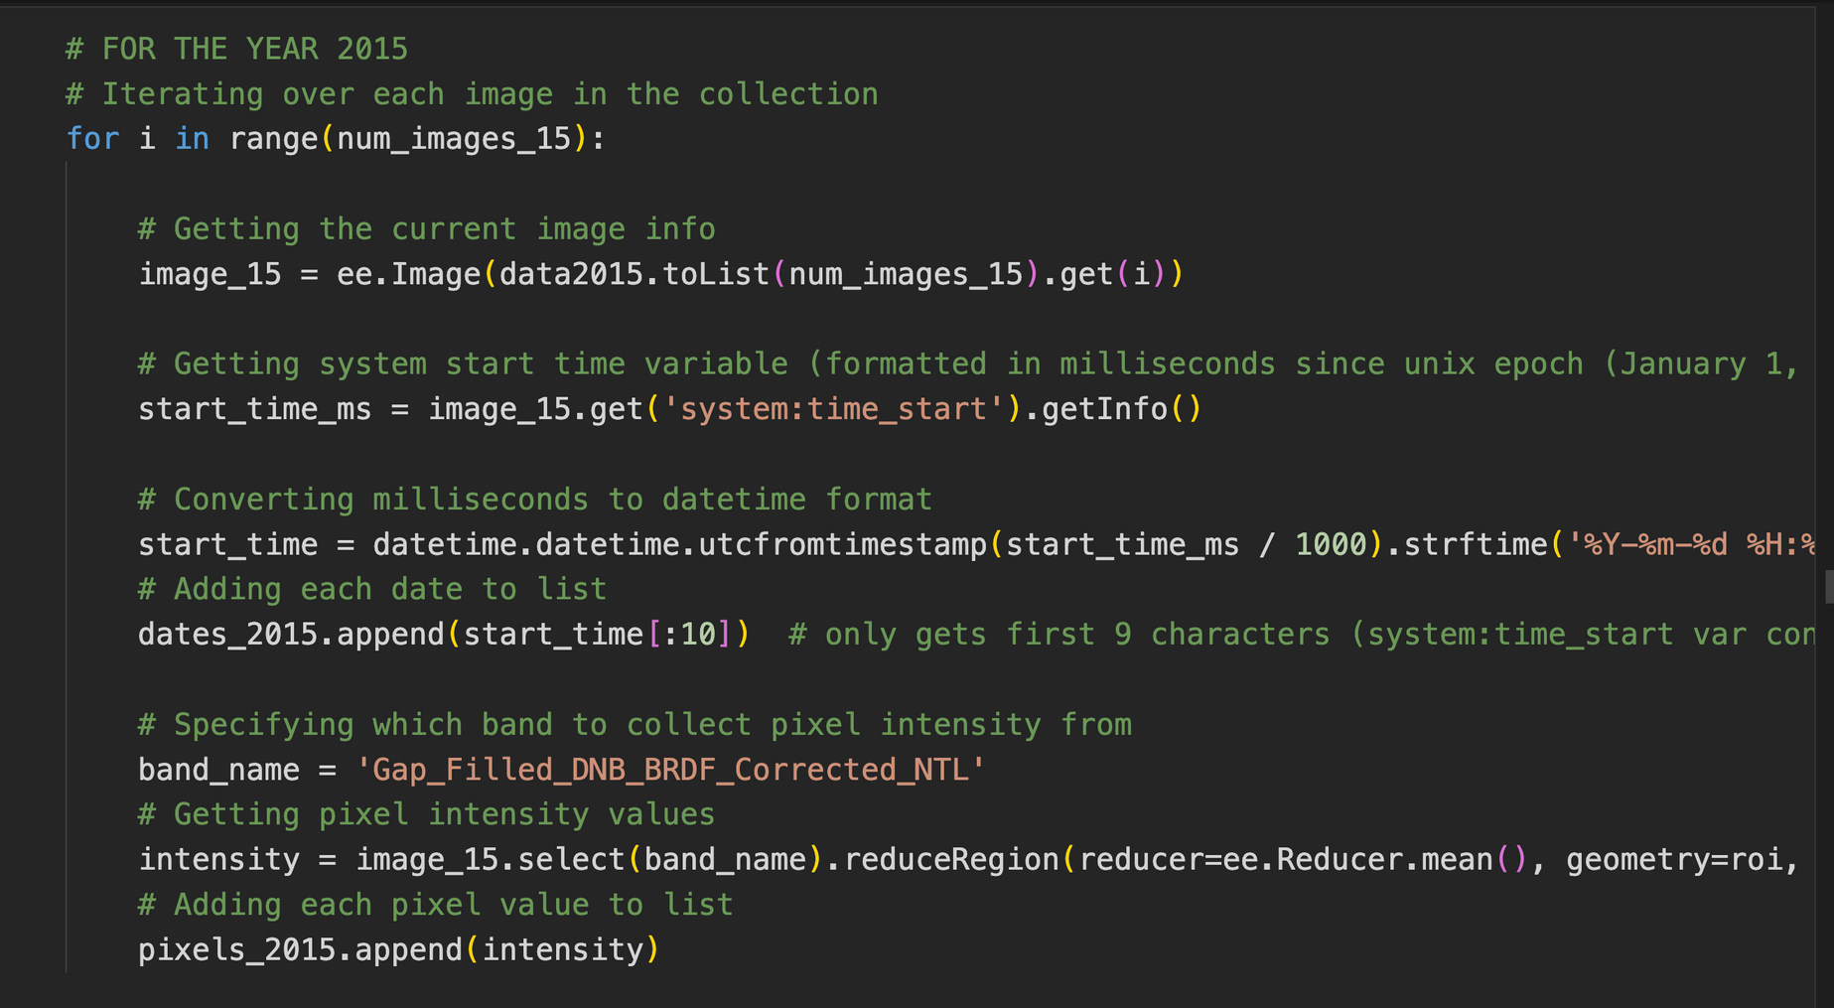

Slide 8
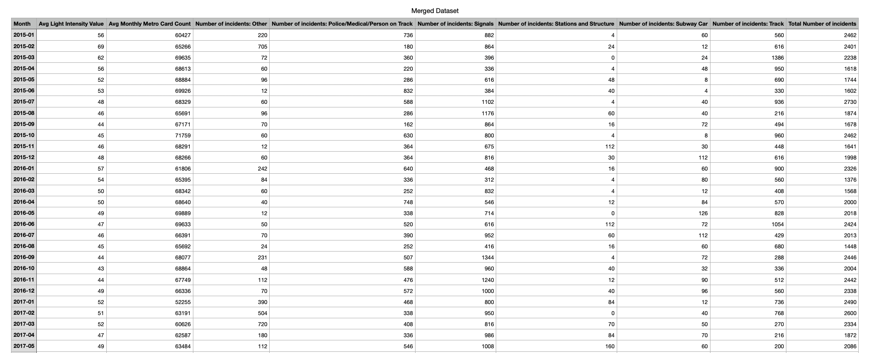
FINAL DATASET
Total of 72 rows representing each month in the year range 2015 - 2020

Slide 9
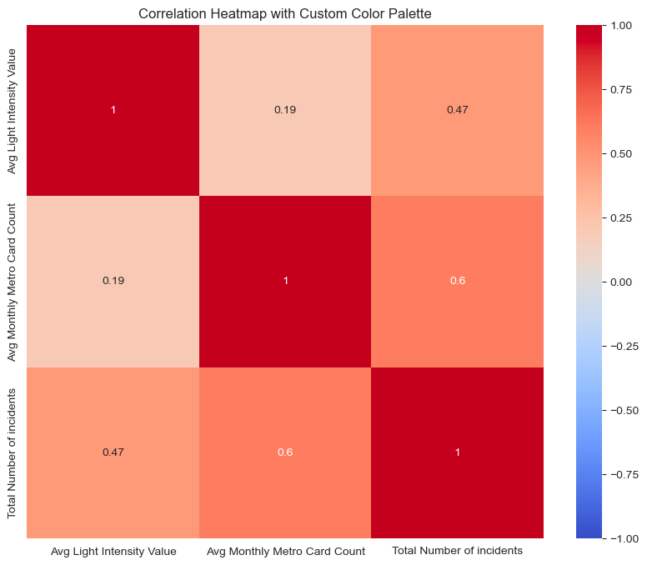
Correlation Visualization
Heatmap
Insights
No negative correlations
Weak positive between Light intensity & Metro card count
Moderate positive between Light intensity & total number of incidents
Moderate but strongest correlation between positive between total number of incidents & metro card count

Slide 10
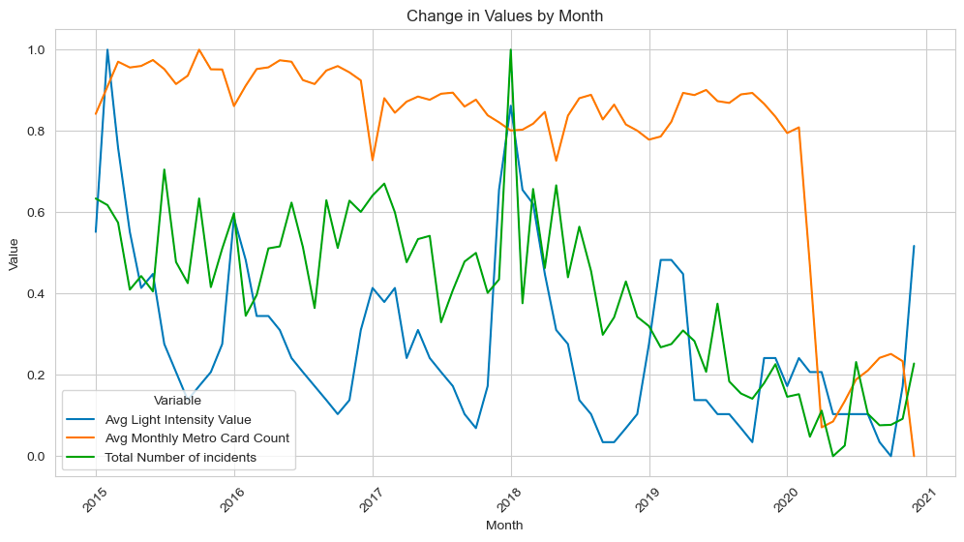
Visualization over Time (Adjusted)
Line Graph
Insights
Visual correlation between Light intensity & total number incidents
Lack of visual correlation of Metro card count with either variable

Slide 11
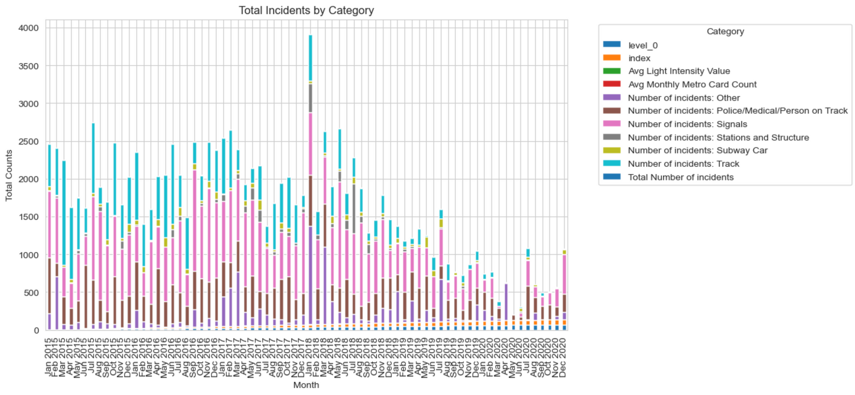
MTA Incident Category Visualization over time
Insights
Graph
Jan 2018 huge outlier
Overall decline in incidents
Most consistent
incidents occurred in Signal, Track, & Police/Medical/Person
on Track categories

Slide 12
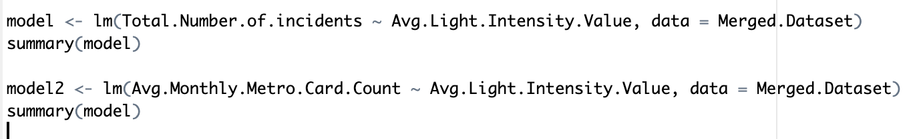
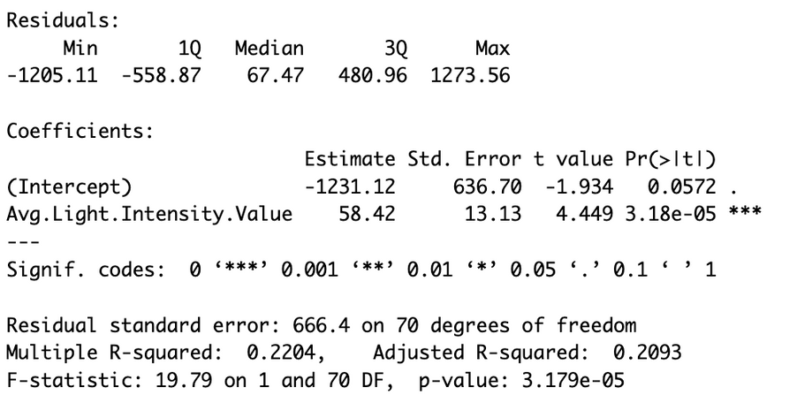
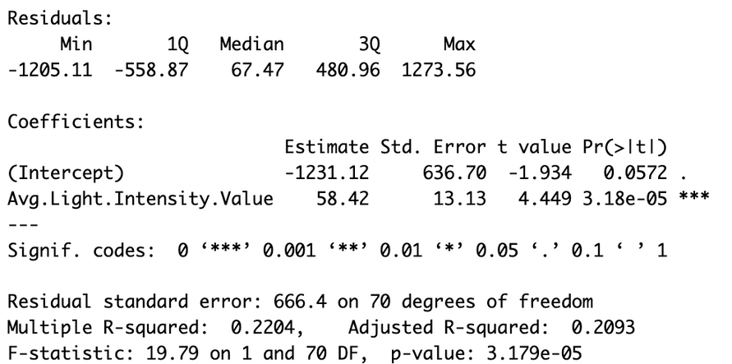
Regressions
Regressing Light intensity on Number of incidents
Regressing Light intensity on Metro card count
1
2

Slide 13
Limitations & Considerations
01
02
03
04
05
06
Variable Scale & lack of location data
NTL data may work better over shorter periods of time and provide more insights on variance by location with more specific location data
Number of Metro cards purchased variable may not be reflective of ridership levels
Correlation between metro card count & total incidents variables
Poor variable choices
Correlation between these specific variables is not really able to translate to causation just due to a lot of factors being involved in urbanization & MTA infrastructure
Time*

Slide 14

Sources
General Help
grouping by both month and year: https://stackoverflow.com/questions/26646191/pandas-groupby-month-and-year
.loc and .iloc: https://pandas.pydata.org/pandas-docs/stable/reference/api/pandas.DataFrame.iloc.html
Resetting indexes: https://pandas.pydata.org/pandas-docs/stable/reference/api/pandas.DataFrame.reset_index.html
Iterating over pandas df rows: https://pythonexamples.org/pandas-dataframe-iterate-rows-iterrows/
folium documentation: https://python-visualization.github.io/folium/latest/user_guide.html
bbox coordinates: https://gis.stackexchange.com/questions/255158/get-minimum-and-maximum-latitude-and-longitude-of-new-york
geodataframe resource: https://geopandas.org/en/stable/docs/reference/api/geopandas.GeoDataFrame.html
homebrew: https://www.digitalocean.com/community/tutorials/how-to-install-and-use-homebrew-on-macos
geometry rectangle: https://developers.google.com/earth-engine/apidocs/ee-geometry-rectangle
Metro Card Counts Variable
Data source: https://data.ny.gov/Transportation/MTA-NYCT-MetroCard-History-2010-2021/v7qc-gwpn/about_data
MTA Major Subway Incidents Variable
15-19 Data Source: https://data.ny.gov/Transportation/MTA-Subway-Major-Incidents-2015-2019/ereg-mcvp/about_data
2020 Data Source: https://data.ny.gov/Transportation/MTA-Subway-Major-Incidents-Beginning-2020/j6d2-s8m2/about_data
NASA NTL Data / Google Earth Engine (method of NTL data download)
NASA BlackMarble user guide: https://viirsland.gsfc.nasa.gov/PDF/BlackMarbleUserGuide_v1.2_20220916.pdf
NASA useful tools: https://blackmarble.gsfc.nasa.gov/Tools.html
NTL dataset Introduction: https://appliedsciences.nasa.gov/sites/default/files/2020-12/BlackMarble_2020.pdf
Python script download resource: https://ladsweb.modaps.eosdis.nasa.gov/tools-and-services/data-download-scripts/#wget
EarthData Forum: https://forum.earthdata.nasa.gov/viewtopic.php?t=4532
How to use Google Earth Engine API for NTL data: https://gis.stackexchange.com/questions/460447/download-nasas-black-marble-vnpa2-nighttime-light-data-using-google-earth-engin
Earth Engine NTL documentation: https://developers.google.com/earth-engine/datasets/catalog/NOAA_VIIRS_001_VNP46A2#code-editor-javascript
Image Visualization & Bands: https://developers.google.com/earth-engine/tutorials/tutorial_api_02
Google Earth Engine Cloud Product Portal: https://console.cloud.google.com/apis/api/earthengine.googleapis.com/credentials?project=nasantl
How to compute from image data: https://developers.google.com/earth-engine/tutorials/tutorial_api_03
Figuring out what product output looks like & how to use it for this research question: https://www.youtube.com/watch?v=KSxlhBLOAc4

